Slide 1
Warhawk Outlanders
Soaring beyond the classroom

Slide 2
Peru 2017
September 30 meeting

Slide 3
198 days to go!
At this point, we are scheduled to leave on Thursday, March 16th I don’t see that changing as the Summit has a set schedule
Agenda
Travel expectations
Passport check
Packing
Fundraising

Slide 4
Travel Expectations

Slide 5
Expectation 1: Be Safe
Safety is the only thing that really matters to me on tour.
Parents care the most about safety, and it is the job of the group leader (ME) to ensure a safe tour.
Safe choices > Fun (because it is not fun being hurt or in trouble)
Always with a chaperone – I will never knowingly leave a student alone anywhere
On-time to bed and to breakfast and all places in between

Slide 6
Expectation 2: NO ALCOHOL
We are now under district policy and now ALL district rules apply.
Not only can your traveler get sent home (on the parents’ dime) for drinking, they can also face disciplinary action from the district upon return.

Slide 7
Passport Check

Slide 8
Passport check
Do you have yours?
If not, please apply for it ASAP.
If parents are divorced, BOTH must be there in person to apply. If the ex can’t be there, there are instructions on the State Department’s website that need to be followed.

Slide 9
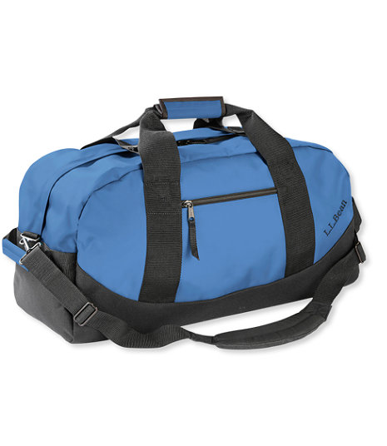
Packing

Slide 10
Carry on ONLY at this point
This may change once I see our flights
Checked bags can get lost
It takes a VERY long time to get through customs with checked luggage, we could miss our connecting.
Small plastic wheels break on cobble stone and do NOT store well in overhead compartments
More luggage means more time loading a bus and less time touring
Busses can only carry so much
Cool kids carry on

Slide 11
Packing tips
For the Summit, nicer clothes are needed
Roll and rubber band
Tide packets and sinks
Wear and pitch
Maxi dresses/no jeans
Wearable souvenirs
Fast-drying material
Double-purpose items (rain jacket = cool evening jacket = pillow)
2 pairs of shoes: one slip on type and one pair of GREAT walking shoes

Slide 12
Fundraising

Slide 13
Fundraising
Still not exactly sure how this will play out since we now fall under the district’s rules…
To be continued…

Slide 14
T shirts
Warhawk Outlanders
Soaring beyond the classroom
Peru 2017

Slide 15
Questions?
Next meeting:
TUESDAY, October 27

